Slide 1
Energy-Aware Conversation Classifier
Priscilla Cheng & Greg Cusack
3/22/17
Notes:
Greg

Slide 2
Problem Statement
Current classification methods are usually
High Power
Immobile
Solution:
Design a low-power, mobile conversation classifier
Utilize new Matrix Creator and interface with Raspberry Pi
Notes:
Greg
Current speech and sound classification technologies are often energy intensive as they have to be in the always-on state to listen for a command
Design conversation classifier that can be used during meetings or conferences that produces a report on speakers
Mention battery powered

Slide 3
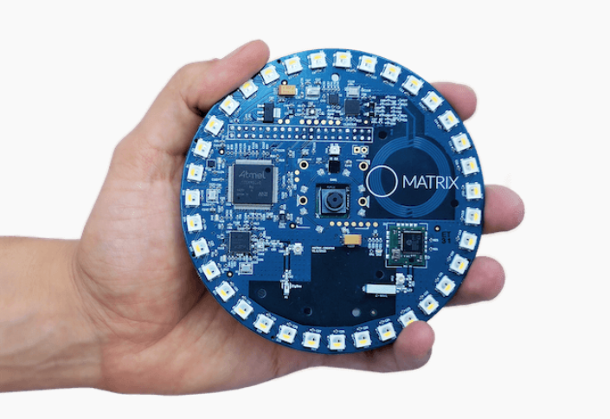
Requirements & Constraints
The system will:
Identify speakers
Track speaking duration
The system will be:
Low power
Mobile
Constraints
System will be developed on:
Matrix Creator
Raspberry Pi
Matrix Creator
Source: http://www.electronicproducts.com/Board_Level_Products/Communication_Boards/With_15_built_in_sensors_the_newly_launched_MATRIX_Creator_is_one_of_the_most_IoT_ready_dev_boards_to_date.aspx
Notes:
Greg

Slide 4
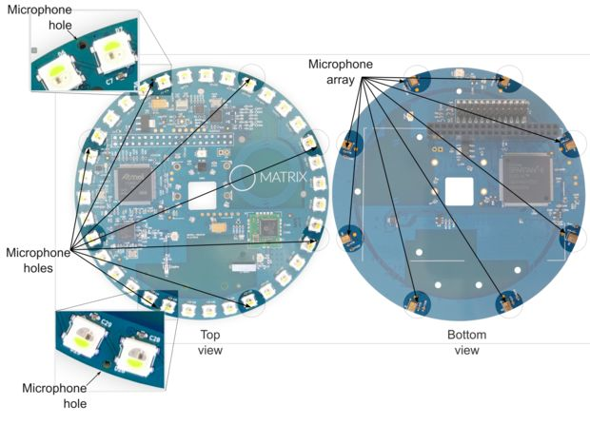
Matrix Creator
Eight microphone array
Developed at Hardware Abstraction Layer (HAL) in C++
Drivers provide method to send data via SPI to Pi
Developed solely for Pi
Source:http://www.instructables.com/id/Build-a-DIY-Amazons-Alexa-With-a-Raspberry-Pi-and-/step2/MATRIX-Creator-MEMS-Microphones/
Notes:
Greg
The matrix creator is a raspberry pi shield. It plays the role of data collector. It serves as a method for the Raspberry Pi to acquire speech samples. The two main abstraction layers on the MC are the Matrix-OS and the Hardware Abstraction Layer (HAL). The HAL interfaced directly with the MC drivers and provided the most control over the system. As a result, all development was performed at the HAL. A state machine with three states was implemented in C++ in order to collect speech data and send it the python script for classification.
Drivers provide method to send microphone data via SPI to Pi

Slide 5
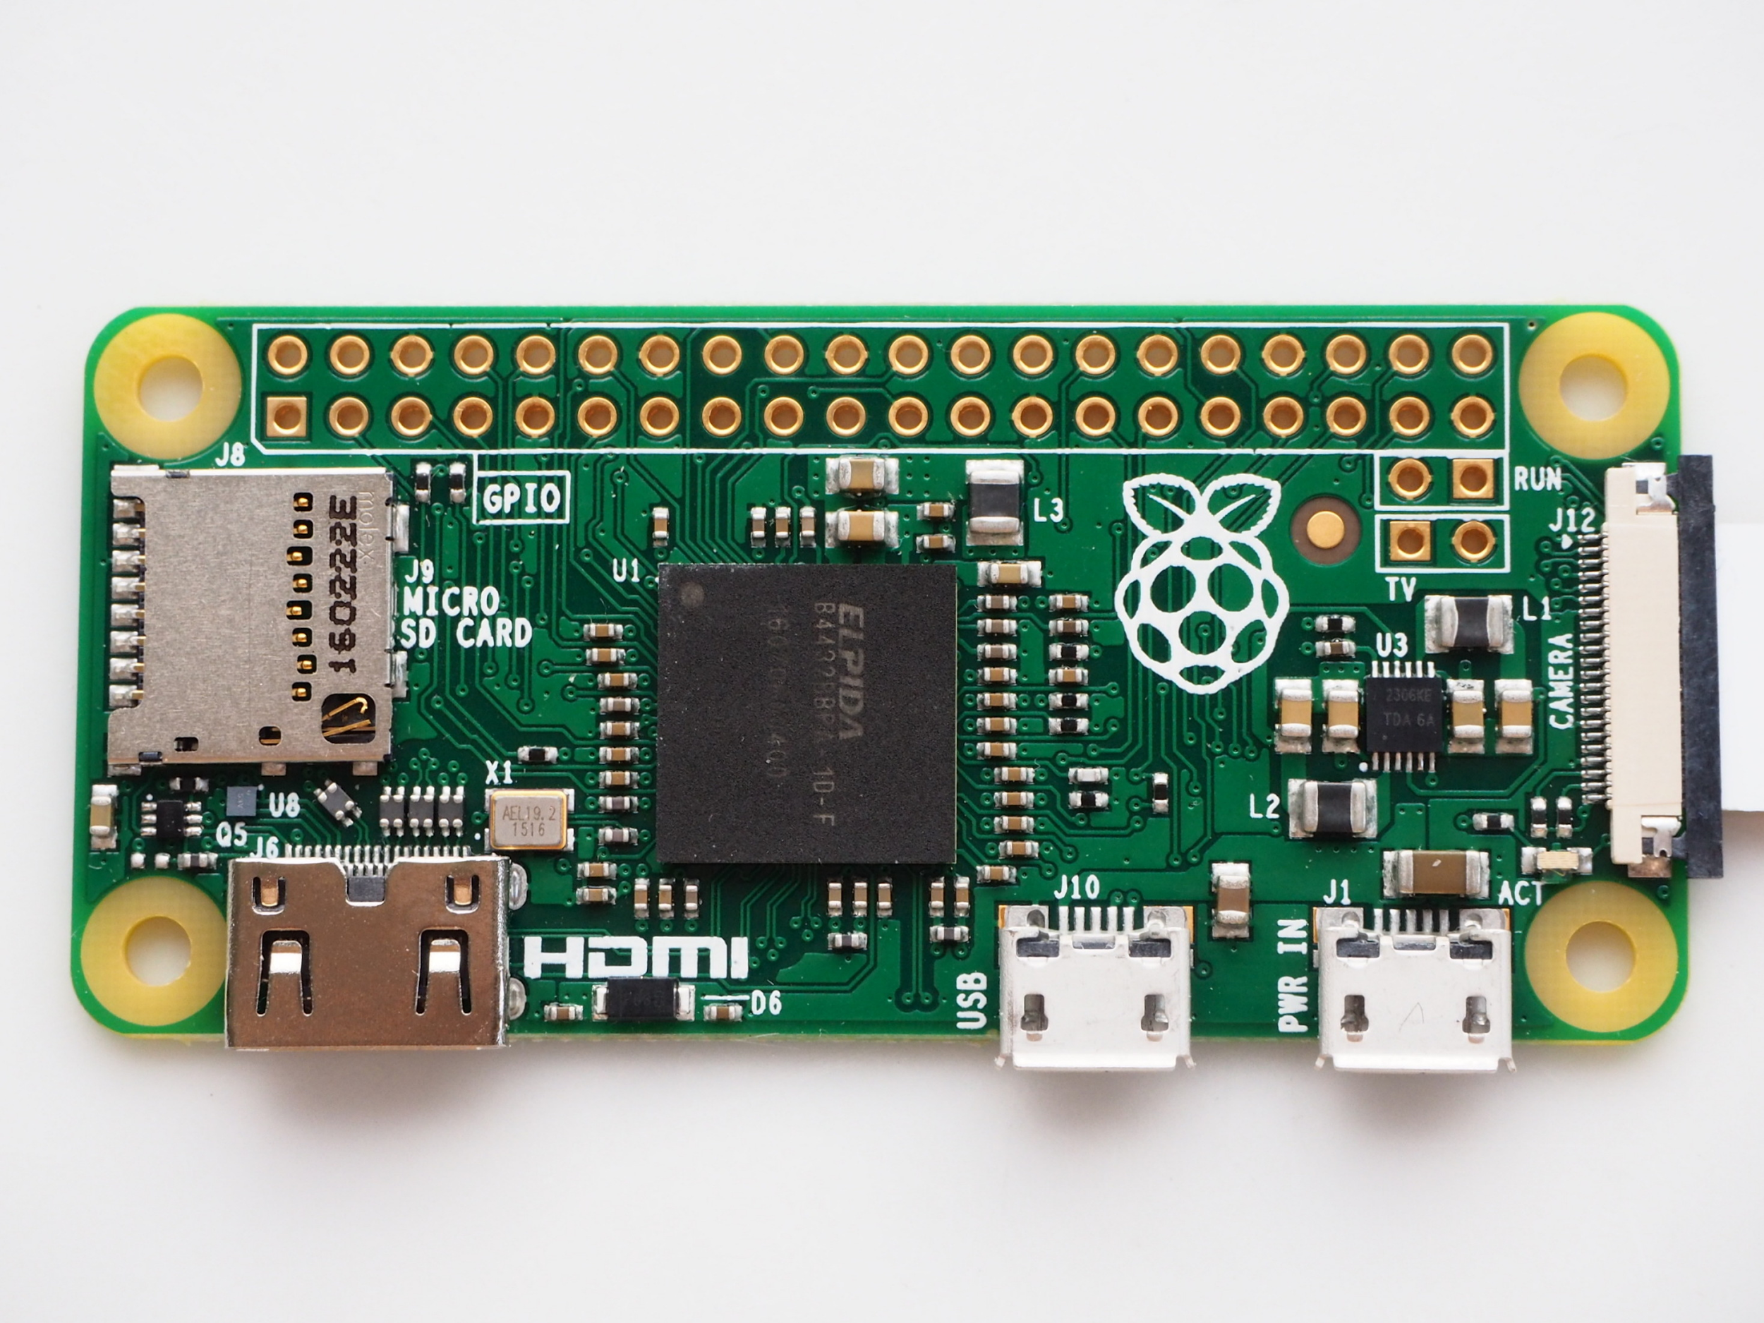
Raspberry Pi Zero
Simplified version of Pi 3
Single Core
No onboard Wifi chip
Low power tradeoff is computational capability
Classification computation too slow for reasonable latency constraints
Raspberry Pi Zero
Source:
https://www.raspberrypi.org/blog/zero-grows-camera-connector/
Notes:
Greg
The Raspberry Pi Zero is a simplified version of the Raspberry Pi 3. It only has one core and has no onboard wifi chip; therefore, making it much more low power. However, the low power comes at a cost of computational capability. The heavy computational requirements of classification proved to be too intense for the Pi Zero at a reasonable latency. As a result, the Pi Zero proved to be a poor fit for the real time constraints of the application.

Slide 6
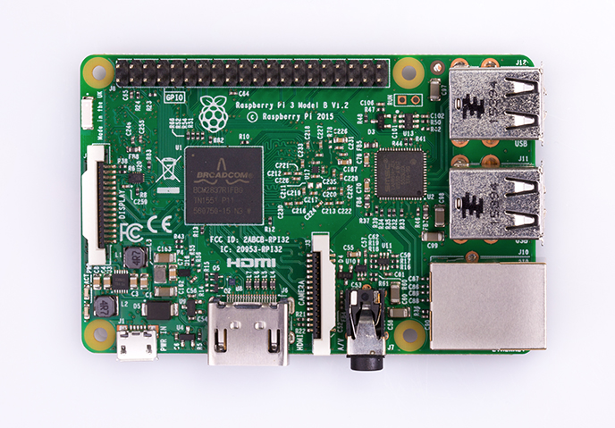
Raspberry Pi 3 Model B
1.2GHz Quad-Core CPU
Wifi card built in
4x USB Ports
Higher power
Source: https://www.raspberrypi.org/products/raspberry-pi-3-model-b/
Notes:
greg
We did not think we would use this, we wanted to use the intel edison but matrix creator was built for raspberry pi
Classification computational ability turned out to be deal breaker. This one could compute results in a realtime

Slide 7
Matrix Creator Data Flow
Notes:
Greg
So what’s the overall goal. Acquire microphone samples from Matrix Creator and feed those samples into a python classification process which will predict the current speaker.
We have three states here
System waits for outside sound to reach a specific threshold
Reads microphone samples into buffer
3 Stage State Machine
Wait for speaker
Read microphone array
Convert voice data to .wav file
Standby state
Sample smicrophones to receive incoming energy
Once threshold is exceeded, the process enters state two
State two
Reads the microphones and collects data at 16kHz for one second (so 16000) samples
This data is then stored in a buffer on the raspberry pi
Then we enter state 3
State 3
Each microphone data is converted to a .raw file
A shells script is run which converts the 8.raw files into a single .wav file
This .wav file is then used for speaker classification

Slide 8
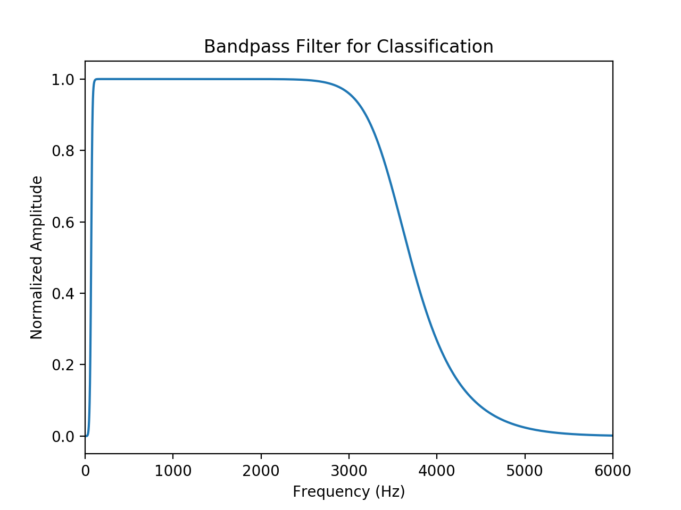
Raspberry Pi Filtering
Initial classification was poor
Added filter
Swept across various bandpass filter frequencies
Selected one which produced best training score
75-3475Hz
Notes:
P Silly

Slide 9
Raspberry Pi Dataflow
Notes:
P Silly

Slide 10
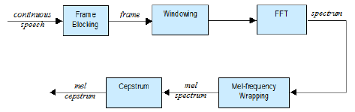
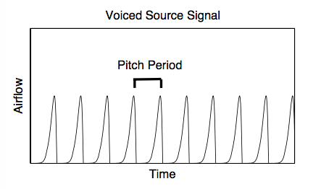
Feature Extraction
Source: https://www.researchgate.net/publication/262321591_Speech_recognition_system_for_cerebral_palsy
Source: Lorenzelli UCLA EE114 notes
Feature extraction increases linearly with time
Energy scales similarly
3 speakers, 20s samples each
800 frames of 512 samples each to train
~40mA on top of the baseline power consumption for 23s duration to extract MFCC and Pitch
Notes:
P Silly

Slide 11
Raspberry Pi Classification
Gaussian Mixture Model: Traditional method for speaker recognition
K-Means Clustering / Vector Quantization
Neural Network:
~50-70mA on top of 0.51A baseline power consumption to train network
~10s training time for 1 hidden layer, 3 hidden neurons
~16s training time for 5 hidden layers, 5 hidden neurons in each layer
SVM:
~40-60mA on top of baseline power consumption to train
~12s training time
Notes:
PSilly: all the classification stuff
We opted for supervised learning methods
Wanted to explore deep learning methods. Also important how it contributes to power consumption and need to be able to train new speakers
Good accuracy when training. Doesn’t test as well, need more samples to train a variety of speech from different speakers
SVM was best suited to a portable / robust application; easier/quicker to train users; if we used neural nets and there was a new speaker to train for, we may be unable to attain a variety of samples from different environments to train with

Slide 12
Multiprocessing
Two processes communicate via shared variable (soundFile.wav)
Notes:
Greg
SoX, the Swiss Army knife of sound processing programs.
SOund eXchange
This way the python process will not read an old .wav file and it will not read the wav file while it’s being written

Slide 13
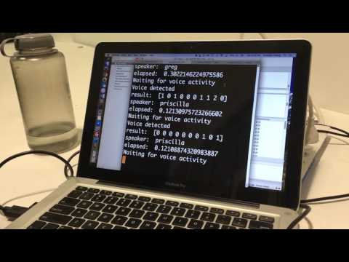

Slide 14
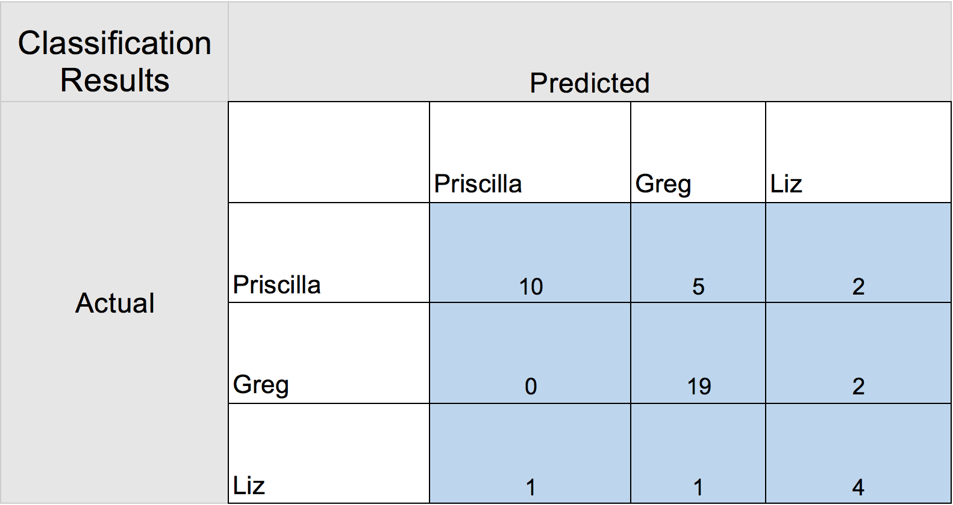
3 Person Classification Confusion Matrix
Notes:
Greg?
Reason we don’t have a lot of Liz samples?
MC did not pick up her voice as much as we thought
Psilly at 60% accuracy
Greg at 90%
Liz @ 66% accuracy

Slide 15
Voice Detection & Processor Sleep State
Voice detection
Constantly read microphone energy level
Can we put to sleep and use interrupts?
No low power sleep modes on Raspberry Pi
Lacks Advanced Configuration and Power Interface (ACPI)
Shutdown state not ideal for necessary real time application
Reboot via falling edge on GPIO1 or GPIO3
35 second startup time
Notes:
Priscilla
Starting from an overall power consumption of 0.55 with the matrix creator attached and 0.22 without
But is there a way to sleep???
-power states, including sleep states are managed by the ACPI.
Due to the lack of ACPI, sleep modes are not possible on the Raspberry Pi.
Matrix creator remains powered
There is one semi-sleep mode that puts the Raspberry Pi to sleep, but it requires a full system reboot upon waking up. This sleep mode can be entered via the command sudo halt. In this state, the system (Pi with Matrix Creator attached) draws 0.31A, which is 56% of the baseline current consumption. The halting state is similar to the shutdown state in that it does not save Raspberry Pi state. The processor wakes up to a falling edge on GPIO1 or GPIO3. Unfortunately, powering up from this sleep state takes 35 sec compared to the usual 50 sec. For this reason, the Raspberry Pi's sudo-sleep state is not ideal for the necessary realtime application described above.

Slide 16
Frequency Scaling
Goal: Run at a lower CPU frequency when system does not detect a voice
Also examine: Lowest frequency that still gives tolerable classification delay
Approach
Reduce frequency in 100MHz steps, run CPU at constant frequency.
Find optimal frequency classification should be run at
Step between min and max frequencies with ondemand governor
Notes:
Priscilla
At a lower frequency, we can also run the raspberry pi at a lower voltage to save power
Approach is to step down the frequency, run classification at constant frequency, get max power savings Lowest recommended is 100MHz. Set governor to powersave, adjust min frequency in config file
Then use ondemand/conservative governor

Slide 17
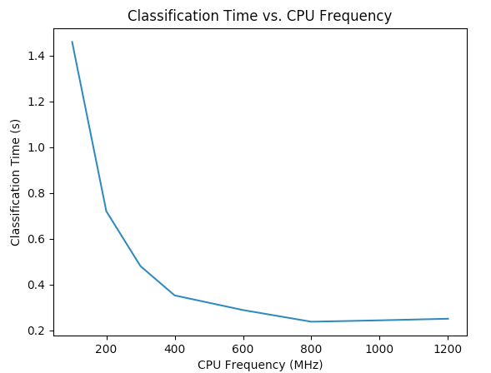
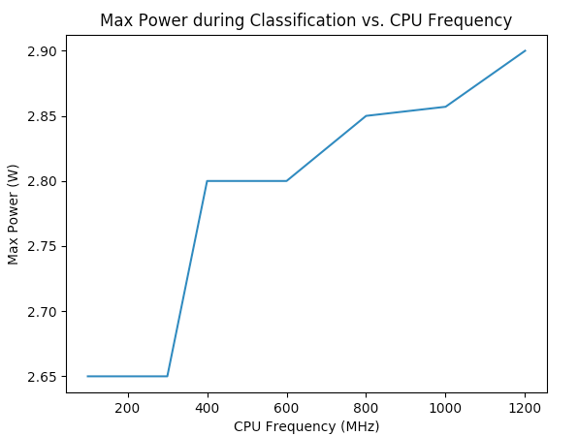
Speed vs. Power Tradeoff
Notes:
Priscilla
Surprising results: at first glance running in performance mode at max frequency set for the ARM cores doesn’t consume significantly more energy when system is listening/idle in comparison to the rest of the rpi system. [need to be able to monitor change in energy over time but we leave this to future work]
This is in line with others online that have attempted the same
Scaling voltage
13.7% power increase from idle power to

Slide 18
Eliminating Pi Peripherals
Raspberry Pi versatility comes at price of power consumption
Shutdown peripherals
Triggerhappy Daemon and LEDs
Bluetooth Interface
~5mA saved
HDMI port
~20mA saved
USB/Ethernet/Wifi share same bus!
Notes:
Greg
Triggerhappy daemon deals with the processing of data coming in from external components such as a keyboard and mouse
Don’t forget to meniton why we could not turn off USB/Etherney
-It’s on same bus as wifi! Turns off wifi too
Cores are being clock gated when not used, so turning off cores does not really help
RPi has no power management capability
Reducing maxCPUs to 2 increased power consumption by 30-40mA

Slide 19
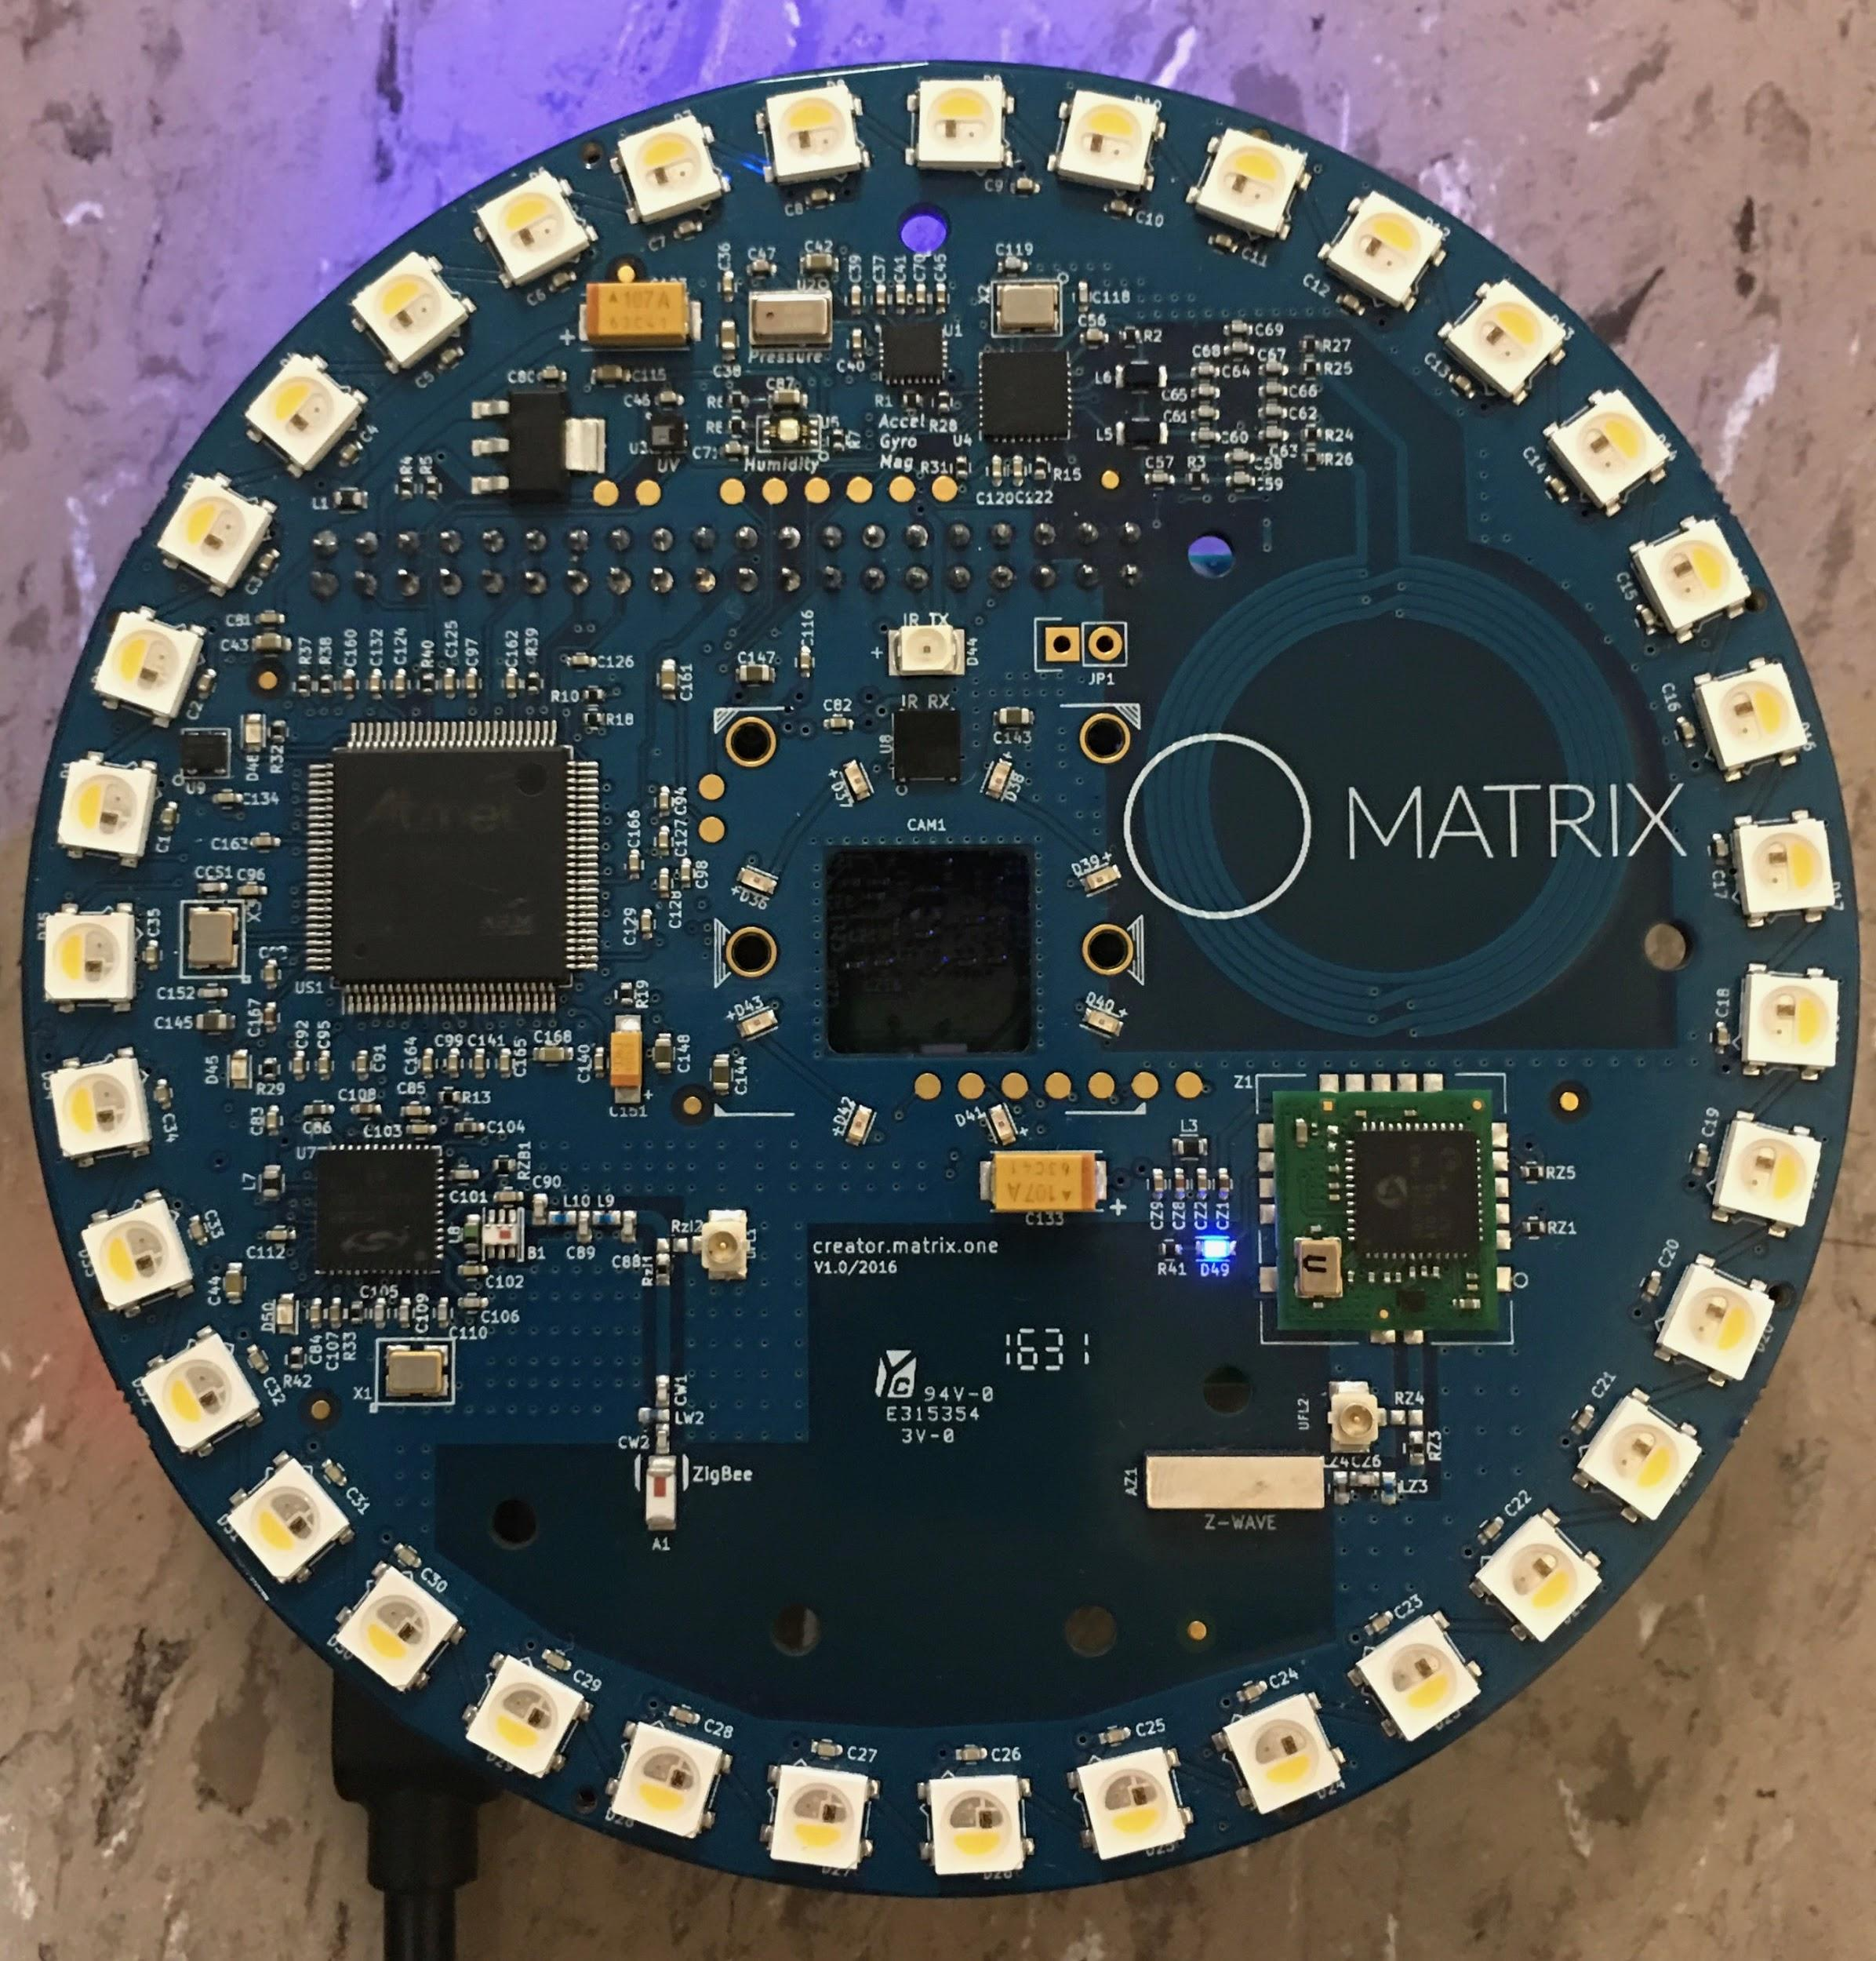
Eliminating Matrix Creator Peripherals
Superfluous component interfaces shutdown
ZigBee
Z-Wave
MCU
IR Transmitter/Receiver
Must leave on FPGA
Communicates with Pi via SPI
Power savings: ~20mA
Notes:
Greg
These were shut down via the /usr/share/admobilize/matrix-creator folder
Within creator-init.bash and the config folder: boot-modifications.txt
Data sent through FPGA, no need for MCU. BUt requires FPGA!
FPGA is big power eater! ~30mA

Slide 20
Overall Power Saving
Initial idle power
0.55A
Biggest power savers
HDMI: ~20mA
BLE: ~5mA
Matrix Creator peripherals: ~20mA
Final idle power
0.50-0.51A
Total saving: ~45mA
Notes:
Greg
We realize this is not ideal but we cannot put the raspberry pi to sleep, the hardware does not support it

Slide 21
Future Work
Speaker diarization / unsupervised learning
Differentiate conversations and provide more detailed report
i.e. 'Person X spoke from t₁-t₂ during conversation C, which took place from T₁-T₂’
Measure energy threshold using only one microphone
Independent Component Analysis
Separate out speakers speaking at same time
Notes:
Priscilla

Slide 22
Final Notes
Combined power consumption of Pi and Matrix Creator is too high for battery operated classification device
Matrix Creator provides extra, power sucking features
Notes:
Priscilla/greg
Unfortunately, due to the Pi's lack of USB to Serial support and the Matrix Creator using all of the Pi's I/O pins, serial interface was not practical.
The Matrix Creator simply sends microphone data to the Raspberry Pi. As a result, the Matrix Creator provides extra features that are not needed for the current application. It ends up consuming more power than it needs to even after peripheral components are shut off.

Slide 23
Conclusion
Three person speaker classification achieved via:
Matrix Creator microphone array
Voice filtering
SVM
Power consumption improved but not suitable for battery operation
Lack of true sleep mode inhibited idle power performance
Notes:
Priscilla

Slide 24
Questions?

Slide 25
